Slide 1
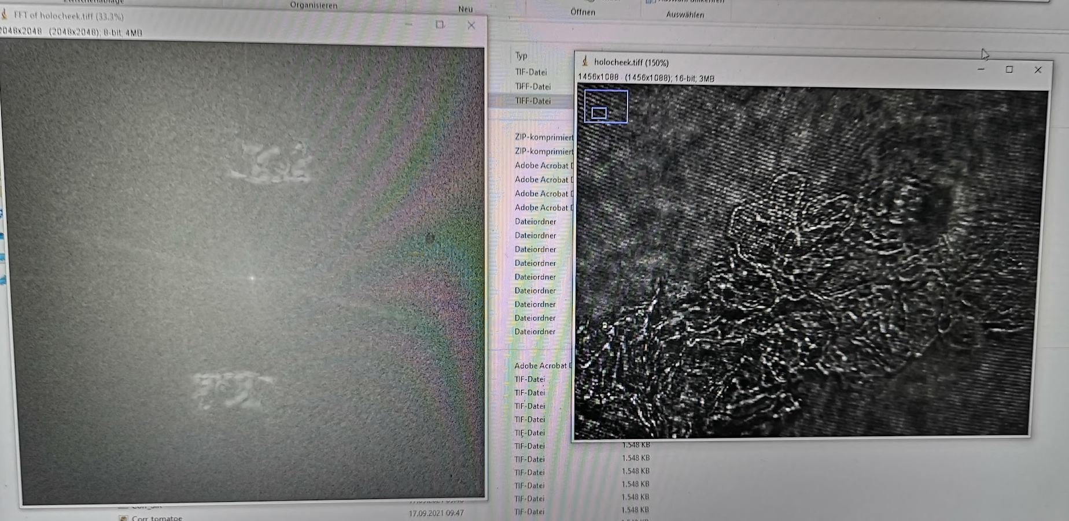
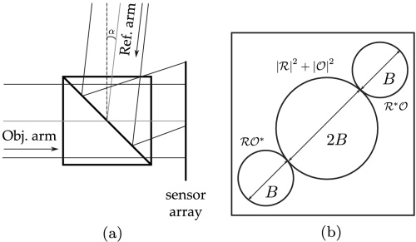
Off-Axis Holographic Setup
MO
CAM
BS
L1, 75mm
MO, 10x
M
MO
XYZ
BS
DM
M
PH
L2, 50mm
M
CAM
Laser

